Slide 1
HUMAN OBSTACLE DETECTOR
Overview
Deliverables
Technology Used
Project Model
Organizational Structure
Assumptions, Dependencies and Constraints

Slide 2
HUMAN OBSTACLE DETECTOR
Risk Management
Methods, Tools and Techniques
Project Support Functions
Work Packages and Dependencies
Resource Requirements

Slide 3
QUAD CHART

Slide 4
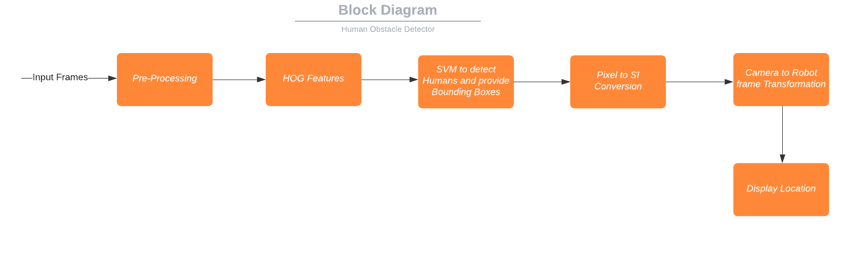
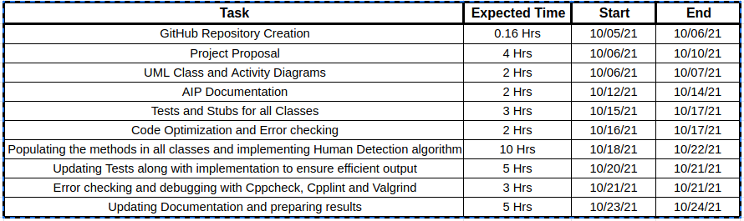
Human Obstacle Detector
Abhishek Nalawade | Aditya Jadhav
Overview:-
Detecting Human Obstacles is by far the most critical task of any autonomous system that is deployed in the presence of humans. Consequently the algorithms in place need to be robust, reliable and efficient at detecting humans.
We attempt to implement a perception algorithm to detect and track humans in a set of input frames for the robotics-based product of ACME Robotics using HOG Feature Descriptor combined with the Support Vector Machine Model.
Methodology:-
Recent advances in deep learning offer extremely efficient approach to this problem but at the expense of cost.
We will use a Monocular Camera from which to take the input frames.
Our method uses Histogram of Oriented Gradients feature extractor and the OpenCV Support Vector Machine functionalities.
How:-
Timeline:-

